Slide 1
FISG CGI Payments IP 101
CGI All Payments

Slide 2
Background & Objectives
Background
Objectives
Some of the Members of Payments group unaware of the other IPs
To enable members to assimilate the basics of domain
To empower members
To be able to relate domain and the software being developed
To be able to appreciate the business need of the IP being worked upon
To enable members to assimilate the functional and technical aspects of other IPs within the Payments group
To be able to relate to the overall payments domain big picture
To be able to appreciate the business need of the IP being worked upon
To enable members to be able to work across multiple products in same domain

Slide 3
Agenda
1
Overview of CGI in Banking
2
CGI APS Product Overview & Features
3
CGI APS Roadmap
4
CGI APS Deployment – Case Study
5
CGI APS Competitor position

Slide 4
Overview of CGI in Banking

Slide 5
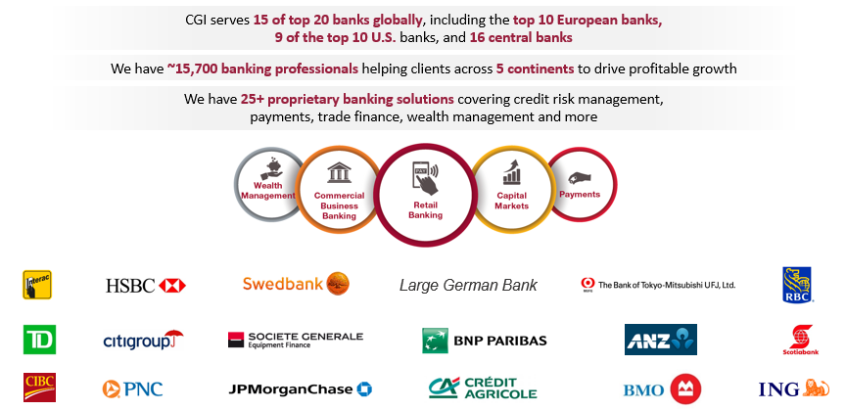
CGI in Banking

Slide 6
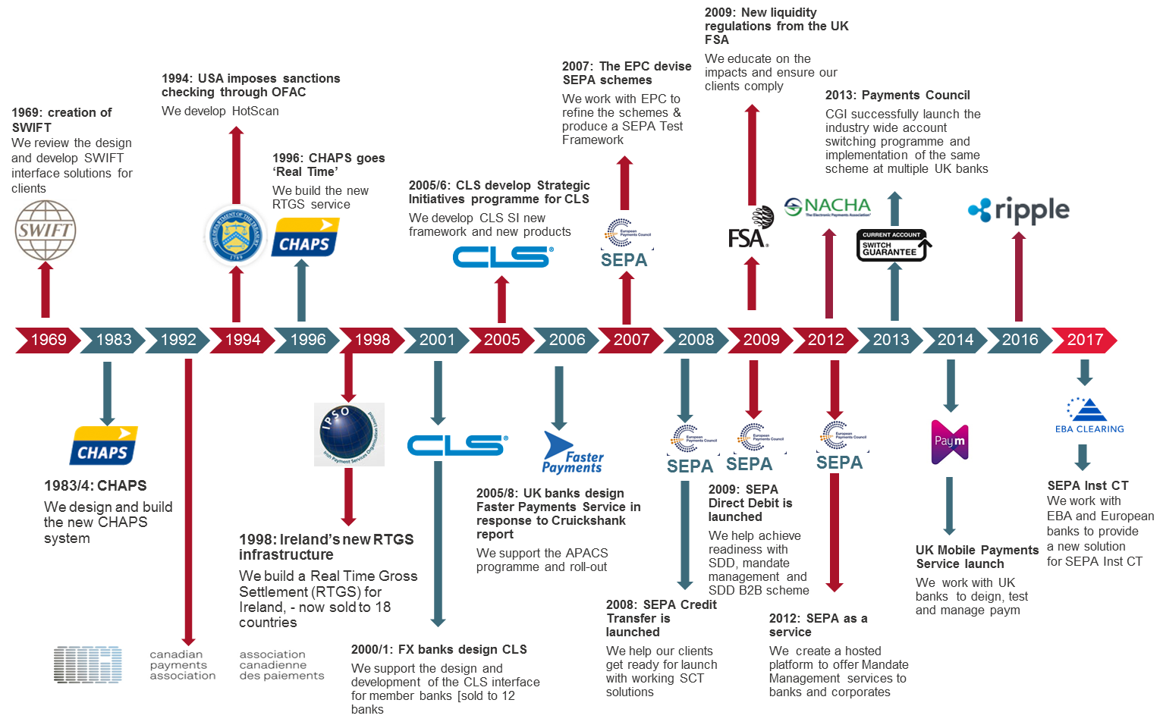
Deep domain expertise, extensive heritage in Payments

Slide 7
CGI’s Footprint in Payments
40% of global foreign exchange (Fx) settlement volume processed by CGI
20% of SWIFT message volume transferred by our financial software solutions
35% of US wire transaction volume handled by CGI
70% of the world’s top financial institutions have partnered with CGI, including 8 of the top 10 global banks
CGI has designed and implemented market infrastructures and central bank payment systems for more than 40 countries
CGI All Payments is currently deployed, or is in the process of being deployed, with major financial institutions in North America, Europe, and Asia

Slide 8
Challenges banks face in payments industry
Reduction in traditional revenue streams and as a result, increased pressure to reduce transaction costs and streamline payment operations.
Inflexible and outdated legacy payment systems that do not comply with upcoming regulatory changes (ISO 20022).
Legacy payment systems that require frequent and expensive change requests, often requiring workflows to be modified and/or new functionality. A problem that may result in additional long-term costs and prohibit the creation of new revenue streams.
End user demands for instant/faster payments that cannot easily be met by legacy systems.
Market disruption from non-bank, FinTech payment solutions (Venmo, Amazon, TransferWise, etc.), offering increased speed and ease of payments.
Growing security and liquidity management obligations, and the additional cost and work required to meet these obligations.
Low Straight-Through-Processing (STP) rates that require significant levels of manual intervention and back office effort, resulting in increased cost.

Slide 9
CGI APS – Product overview and Architecturet Overview & Features

Slide 10
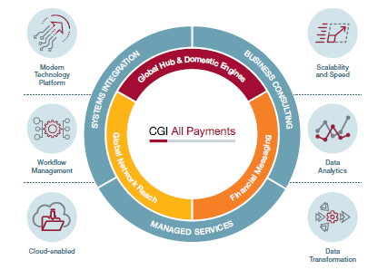
CGI All Payments – The Answer
CGI All Payments provides a best-in-class payments solution, enabling our customers to standardize and modernize their payments ecosystem
CGI All Payments facilitates the delivery of greater value within a banks payments ecosystem and provides the foundation to support a bank’s digital channel strategy
CGI All Payments provides standardized options for the integration of legacy payment ecosystems and third-party applications
Target markets - Financial institutions
Tier 1 - Large global financial institutions such as J.P. Morgan, Goldman Sachs, Citi Group, Bank of America.
Tier 2 – Large to medium sized financial Institutions with a global presence such as Barclays, Credit Suisse, Canadian Imperial Bank of Commerce (CIBC) - Existing clients include Deutsche Bank and National Bank of Canada (NBC).
Tier 3 – National or regional financial institutions such as credit unions, savings and loans, and building societies that may also use third-party providers for their payment systems

Slide 11
APS Overview and Growth Strategy
APS Overview
Multi-currency / lingual / workflow / channel / tenancy
Modern, open platform, component based
Highly-configurable workflows (batch & RT)
High performance payment engines and hub architecture
Next generation standards (e.g. ISO20022)
Next Generation Payment Hub
Format independent processing
Functional Upgrade
Fedwire and CHIPS interfaces (support US and Canadian market)
Digital transformation advanced analytics
Enhanced delivery models
Horizontal scalability utilizing Cassandra database (race to real time)
REST API enabling integration to client UIs
Technological Upgrade
French language addition
Enhance SWIFT payment messages
US ACH interfaces (support US low value market)
Intuitive user experience
Cloud deployment
Test automation
Notes:
Our strategy then becomes to develop high performance engines that is configurable and modular, leverage the CGI financial depth and experience, to offer and focus on a Payments360 solution by providing the SME consulting, IP, SI and hosting, focus and leverage our management and delivery framework.
When we look at how we compare today we see that we do need to invest in our payment network coverage, round our technology stack and also invest in our business development and marketing. With this investment we will not only address our shortcomings but we will be able to leapfrog the competition with our distribution channel reach, our transaction performance engines, payments analytics and financial messaging capabilities.

Slide 12
CGI APS - Modules
Integration Framework
Financial Messaging
Files In
Files Out
Interface Feedback
Services / API
Common Channel Services
Transaction Services
Transaction Initiation (internal)
Dashboards
Liquidity Manager
STE Operations
Check
Manual Capture
Recurring Transactions
Transactions & Batches
Payment Templates
Processing Services
Parties Management
Validate & Enrich
Business Dates
Matching
Prioritization
Warehousing
External Authorization Check
Regulatory Filtering
Limits
Fees and Billing
Distribution
Notifications
Accounting
Reconciliation
FX
Suspicious Payment
Float & Profit Sharing
Tax
Routing & Clearing Partners
Customers & Accounts
Permitted Creditors
Mandates
Core Engine
Real-Time Engine
Bulk Engine
STE Engine
Scheduler
Static Data
Multi-Entity
Internationalization
Partitioning
Archive & Delete
User Security
Application Security
Audit Log & Alerts
Reporting
Printing
UI Framework
Confidential

Slide 13
Integrations – Overview for Wires
Input interfaces
Payment feeders
SWIFT
LVTS
Reference data
Customers and accounts (cache)
FX rates
BICs
Accuity
Gpi SWIFT directory
RMA
Output interfaces
SWIFT – MT & MX
FedWire
LVTS
DDA
Sanctions screening / AML
Fraud detection
FX rates / contracts
Status notifications
Advices
Confidential

Slide 14
System context and Logical flows
Payment Initiation e.g. bank’s Front-End systems and internal systems (“host”)
Client Reporting Engine bank’s reporting system(s)
Hotscan AML compliance check – regulatory scan
Centaur fraud detection, bank’s KYC check
CSM e.g. Clearing and Settlement mechanisms, e.g. NACHA, FEDWire,…
Correspondents Correspondent banking over SWIFT
Core Back Office (CBS) back-end systems holding Customer & Accounts, ledgers, billing systems and rate lists
Manual input e.g. BESS APS channels which are not directly integrated to a counterpart system
Introduction and system context

Slide 15
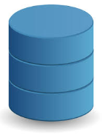
Architecture Overview
Payment Feeders
Browser Client
Identity Provider
Clearing
All Payments
Downstream systems
SWIFT
REST API
AML / OFAC
LVTS
Services
Fraud Analytics
MQ, REST API, SOAP,
SFTP, IBM C:D
MQ, REST API, SOAP,
SFTP, IBM C:D
Workflow Engine
Bulk
Clearing
DDA
Workflow Steps
Real-Time Clearing
Business Rules
FX, etc
Oracle Database
(All Payments)
Cassandra (Cold Storage for In-flight Real-Time Payments)
Confidential

Slide 16
Application Architecture Overview
Confidential

Slide 17
High Availability / Disaster Recovery
Azure Secondary Site
Azure Primary Site
AWS Tertiary Site
Architected to multi-cloud
Auto restart using Kubernetes health probes and Kubernetes load balancing / services
Data geo-replication
Landing zone for payment files (inbound & outbound payments)
Synchronous replication of transaction files dropped to CGI landing zone by Bank to guarantee data consistency between sites
Asynchronous database geo-replication (Oracle Data Guard) is used to maintain performance
Load Balancer
Load Balancer
Load Balancer
HTTPS MQ over SSL SFTP
HTTPS MQ over SSL SFTP
HTTPS MQ over SSL SFTP
Landing Zone
Synchronous Communication
Landing Zone
Synchronous Communication
App server
(active)
App server
(active)
App server
(standby)
App server
(standby)
App server
(standby)
App server
(standby)
JDBC
Secured Private Network
JDBC
Public Internet
VPN
JDBC
JDBC
JDBC
JDBC
JDBC
JDBC
JDBC
JDBC
JDBC
JDBC
Asynchronous Communication
(Latency 25 ms)
Asynchronous Communication
(Latency 44 ms)
Data Guard (Synchronous)
Data Guard (Synchronous)
Data Guard (Synchronous)
DB server
(active)
DB server
(standby)
DB server
(standby)
DB server
(standby)
DB server
(standby)
DB server
(standby)
Current data
Current data
Archive
Current data
Current data
Archive
Current data
Current data
Archive
Backup
Backup
Backup
Two-Site Delivery Model
Confidential

Slide 18

































Technology Stack – Runtime
Browsers
Monitoring Tools
UI Frameworks
Authentication Provider
Reporting
Deployment & Runtime (Public / Private)
Application Containers
Application Frameworks
Databases
Messaging / Transport / Storage Middleware
Confidential

Slide 19


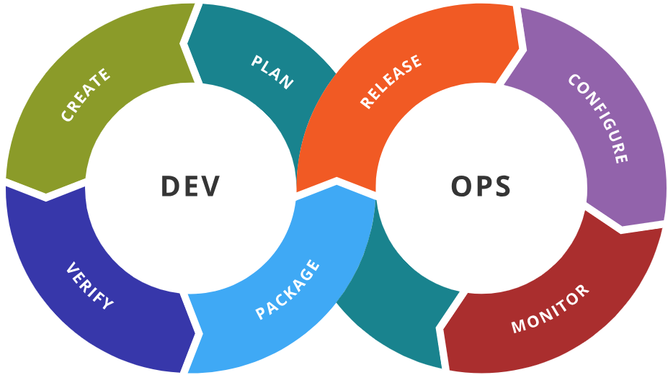






Technology Stack – DevOps
Confidential

Slide 20
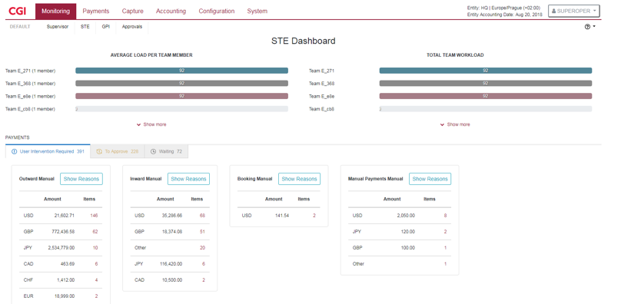
CGI All Payments – Internals
UI Layer
Angular + Bootstrap using REST API
Design consistency & reusability – reusable components
Multi-language
Extensible framework built using the latest UX / technology standards
Great performance, low network footprint – advanced caching techniques
Can integrate with existing environment using REST API
Easy to load balance / failover
Application layer
Workflow based - Reusable workflow components
Configurable static data module to hold
Any sort of reference data
Business decision matrices
(customer cut-off times, OFAC rules, alert notification rules etc.)
UI – Modern UX Design

Slide 21
Deployment Mechanism
Fully automated deployment
Containerized deployment using Docker + Kubernetes
For all components of the solution (Application Server, Oracle Database, WSO2 Identity Server, Boulder CA, SFTP server, MQ server)
Docker images for stateless deployments
Docker jobs for stateful sets (Oracle Database, Cassandra)
alter schema + data migration scripts
Test automation also runs in Docker including interface simulators (downstream systems)
Confidential

Slide 22
CGI APS Deployment – Case study

Slide 23

Payment Hub – National Bank of Canada
What the bank needed
Replacement of legacy platform reaching end of life
Implement a modern payment services hub
Support “like-for-like” functionalities for SWIFT
Provide opportunities for greater process automation and streamlining
Deploy foundational framework for payment hub incl. API, Centralized tools and capabilities
Phased approach to delivery but Agile to accommodate rapid changes
Multi-cloud deployment – to go-live in a couple of months
Increased levels of automation and STP
Implementation of workflow and rules based processing to improve customer responsiveness
Our Answer
Fully automated build, deployment, testing including Continuous Integration and tests
Different business flows covering inward, outward, cheque advises, non-financial messages
Functional modules flexibility – processing steps to cater to different functional requirements
Integration patterns – KAFKA, file based, REST APIs
Support for future initiatives by Paiments Canada – LYNX (replacement of LVTS)
Release 2 and 3 to focus on AFT, EDI and Bulk payments
Value Proposition

Slide 24
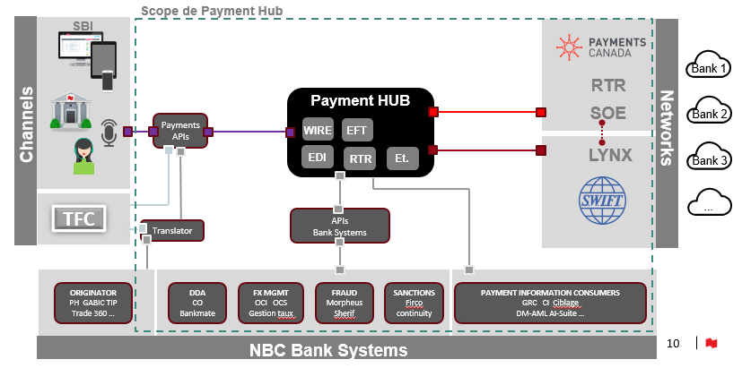
NBC – Target state

Slide 25
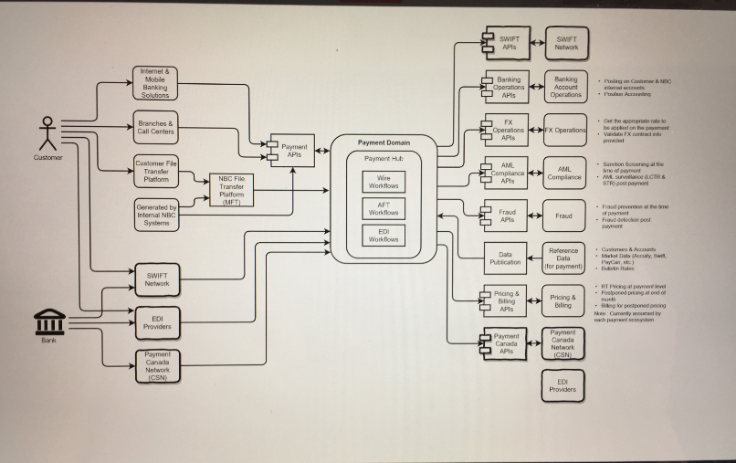
NBC – Deployment Model

Slide 26
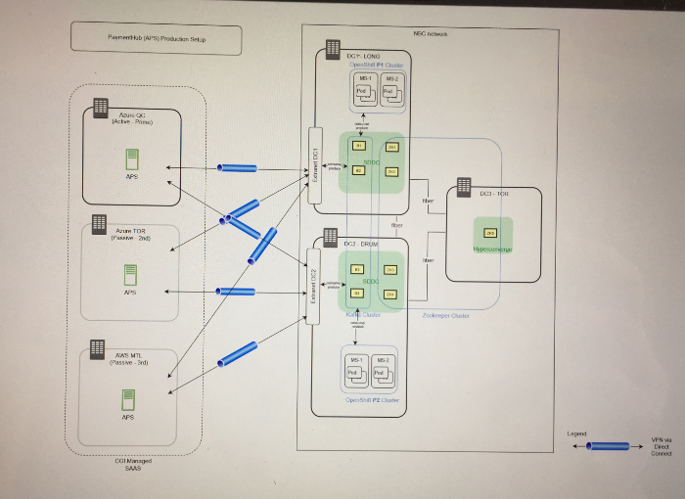
NBC – Deployment Model

Slide 27
CGI APS – Competitor analysis

Slide 28
CGI APS – Competitive position
Knowing the competition we are up against is a crucial element in every sales process. Every (potential) customer will evaluate how we stack up against the competition.
Our competitors:
Finastra (formerly Fundtech) – Global PAYplus
ACI worldwide – ACI Universal Payments
Fiserv (formerly Dovetail) – Enterprise Payments Platform
FIS Global (formerly Clear2Pay) – Enterprise payments
Some of our competitors have:
Large installed client base (Fiserv, ACI)
High value revenue stream through maintenance (ACI, Fiserv)
Reasonable level of private funding (Fiserv)
Better pricing flexibility (FIS Global)
Attractiveness of a single payment architecture (FIS Global, Fiserv)

Slide 29
Our commitment to you We approach every engagement with one objective in mind—to help clients succeed.

